Slide 1
Developing with Db2 Warehouse: A Comprehensive Guide

Slide 2
Introduction to Data Warehousing
Data warehousing is a process of collecting, storing, and managing data from different sources to support business intelligence activities.
It is designed to handle large volumes of data and support complex queries and reporting.

Slide 3
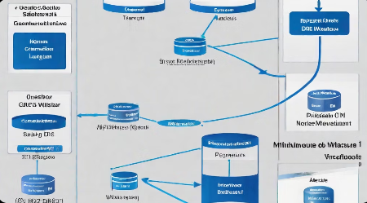
Db2 Warehouse Overview
Db2 Warehouse is a cloud-based data warehousing solution that provides a highly scalable and flexible platform for storing and analyzing large amounts of data. It is designed to support a wide range of workloads, from simple ad-hoc queries to complex analytics and machine learning models.

Slide 4
Data Modeling and Design
Entity-Relationship Modeling
Entity-relationship (ER) modeling is a technique for representing data in terms of entities and their relationships. An entity is a real-world object or concept that has a unique identifier, while a relationship is an association between two or more entities. ER diagrams are commonly used to visualize the relationships between entities and the attributes associated with them.
Dimensional Modeling
Dimensional modeling is a technique for designing data warehouses that emphasizes the organization of data into dimensions and facts. A dimension is a category of data that provides context for the measures in a fact table, while a fact is a numeric value that represents a business metric. Dimensional models are optimized for querying and reporting, and are often used in conjunction with OLAP (online analytical processing) tools.

Slide 5
Optimizing Performance
Indexing and Partitioning
Proper indexing and partitioning of your data can greatly improve query performance.
Data Compression
Compressing your data can reduce storage requirements and improve query performance.
Query Optimization
Optimizing your queries can help to reduce query times and improve overall performance.

Slide 6
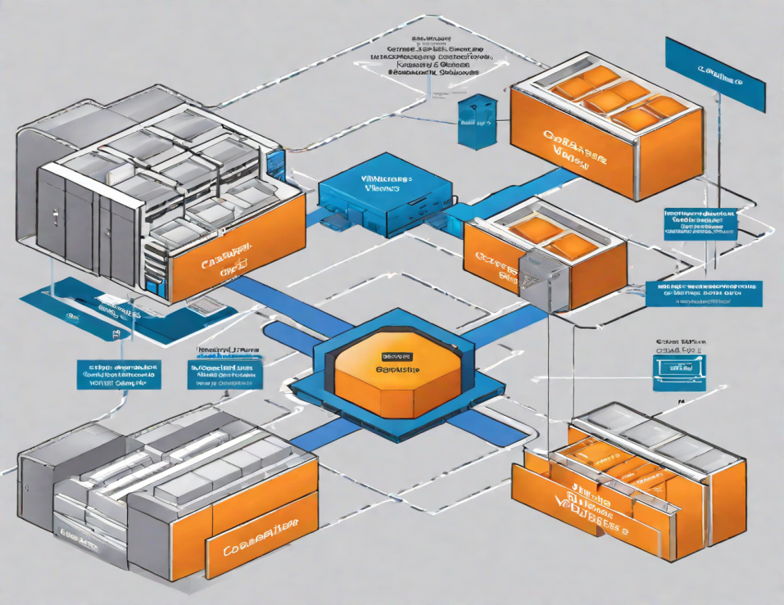
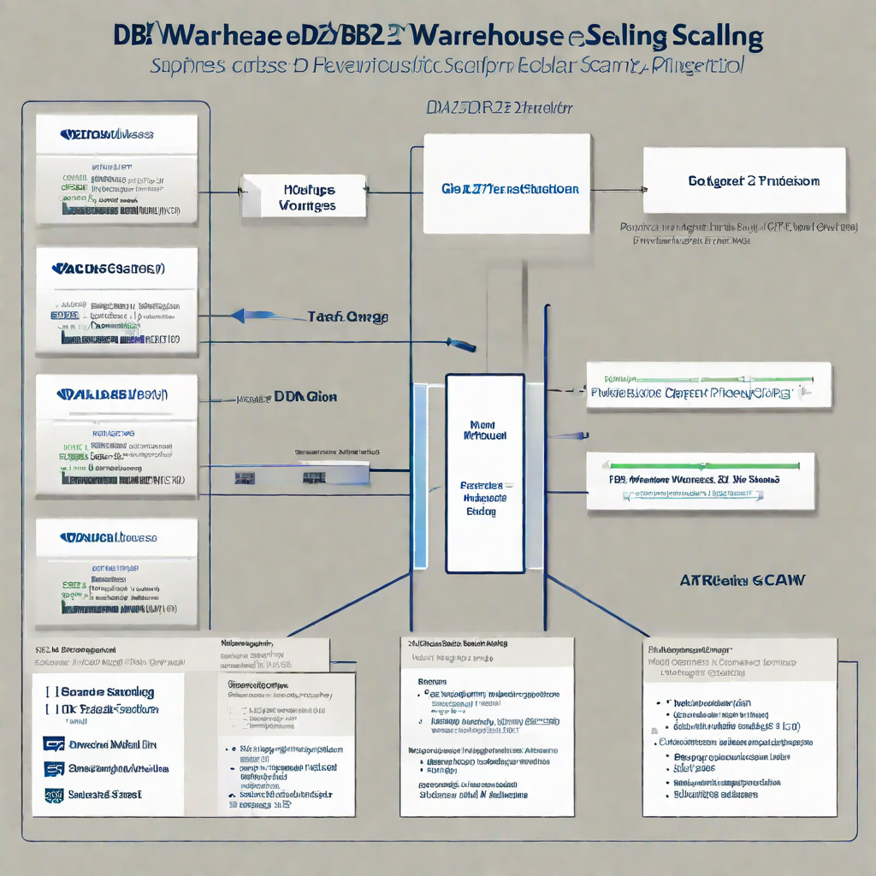
Deployment and Scaling
Deployment Options
Db2 Warehouse can be deployed on-premises, in the cloud, or in a hybrid environment. Each deployment option has its own advantages and trade-offs, and choosing the right one depends on your specific needs and requirements.
Scaling Strategies
Db2 Warehouse can be scaled horizontally or vertically depending on the workload and data volume. Horizontal scaling involves adding more nodes to the cluster, while vertical scaling involves increasing the resources of each node.

Slide 7
Best Practices and Tips
﻿
Use columnar storage for faster query performance.
Partition tables to improve query performance and manageability.
Use compression to save disk space and improve query performance.
Regularly analyze tables and indexes to maintain optimal performance.

